Slide 1
UPDate 02/2014

Slide 2
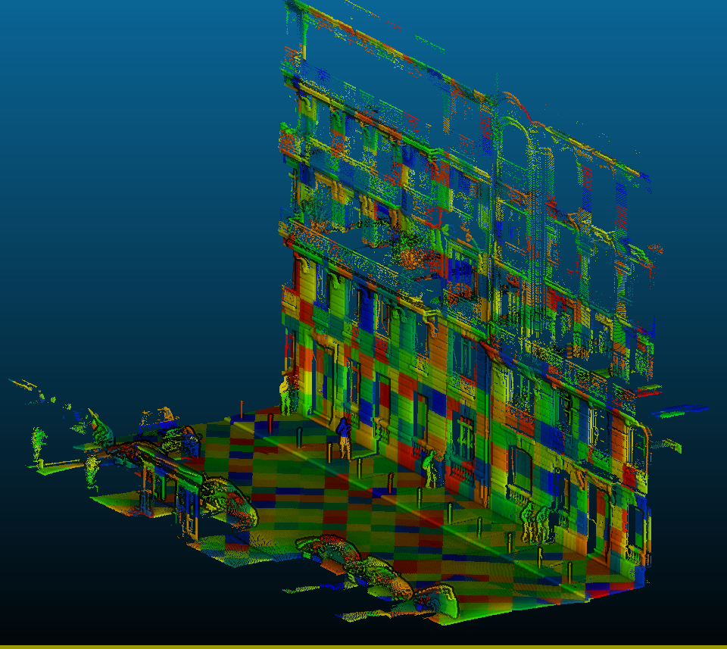
UPDate 02/2014
Corrected minor bugs
Added function to pointcloud to speed data retrieval
Color = gid = 1m2 patch
(note : facade removed for visibility, shader for visibility)

Slide 3
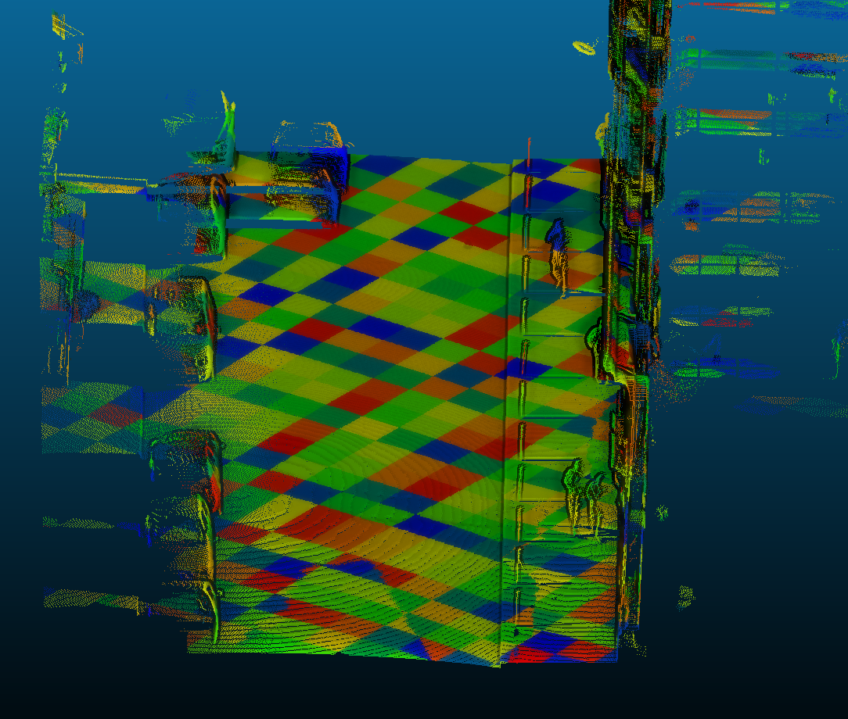
Demo

Slide 4
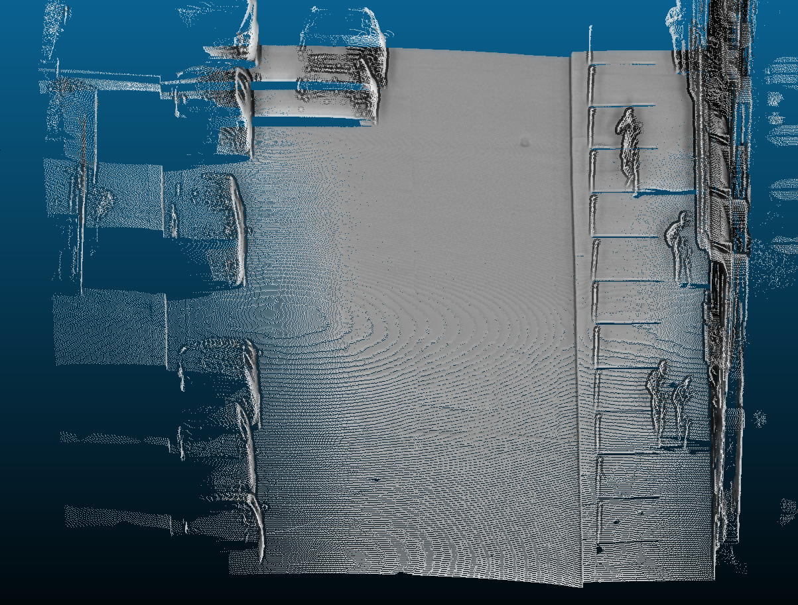
Demo

Slide 5
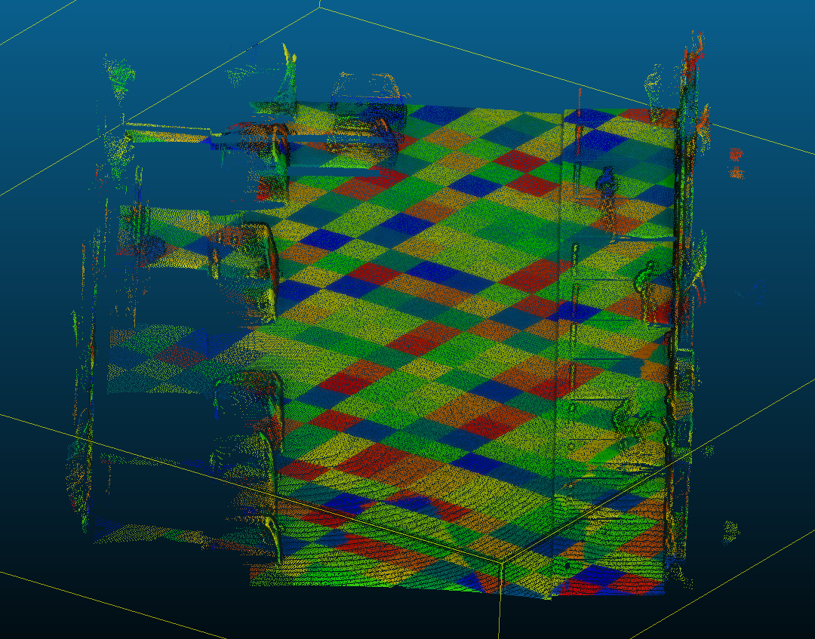
Demo
6

Slide 6
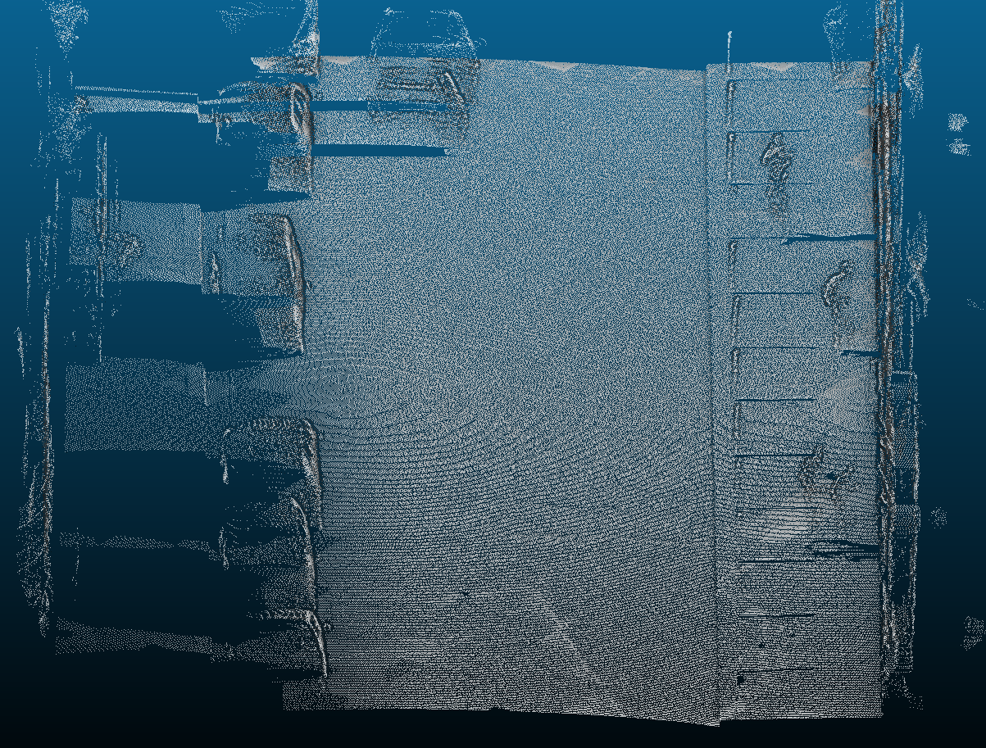
Demo
1+..+6

Slide 7
Demo
1+..+6
(1 to 1365 pts/m2)

Slide 8
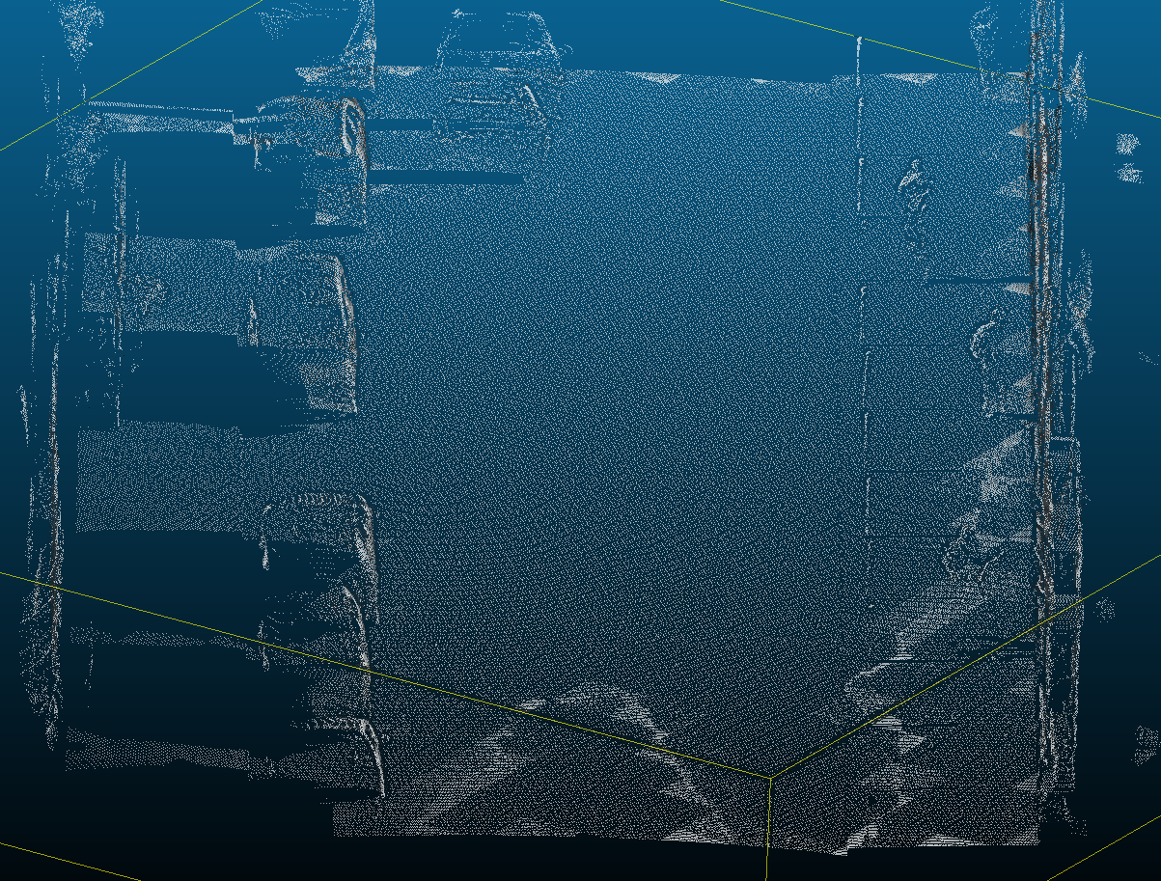
Demo
1+..+5 (1 to 341points/m2)

Slide 9
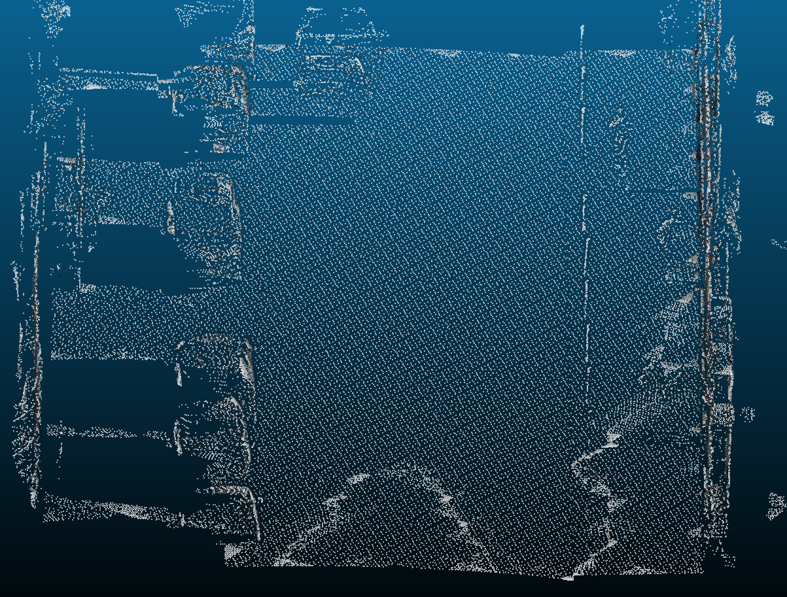
Demo
1+..+4(1 to 85 points/m2)

Slide 10
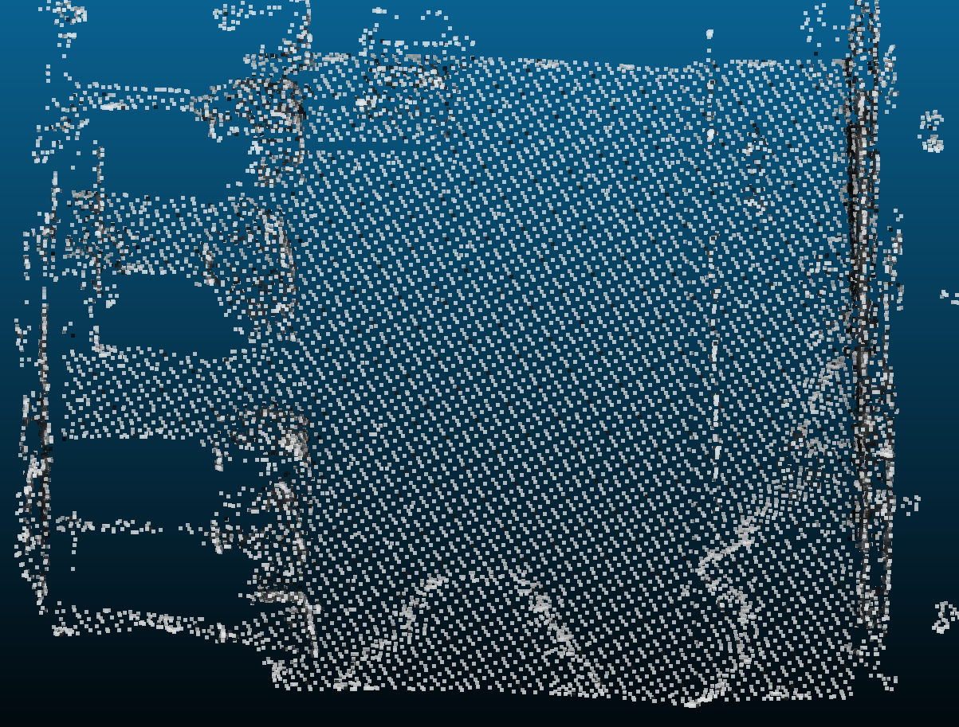
Demo
1+..+3(1 to 21 points/m2)

Slide 11
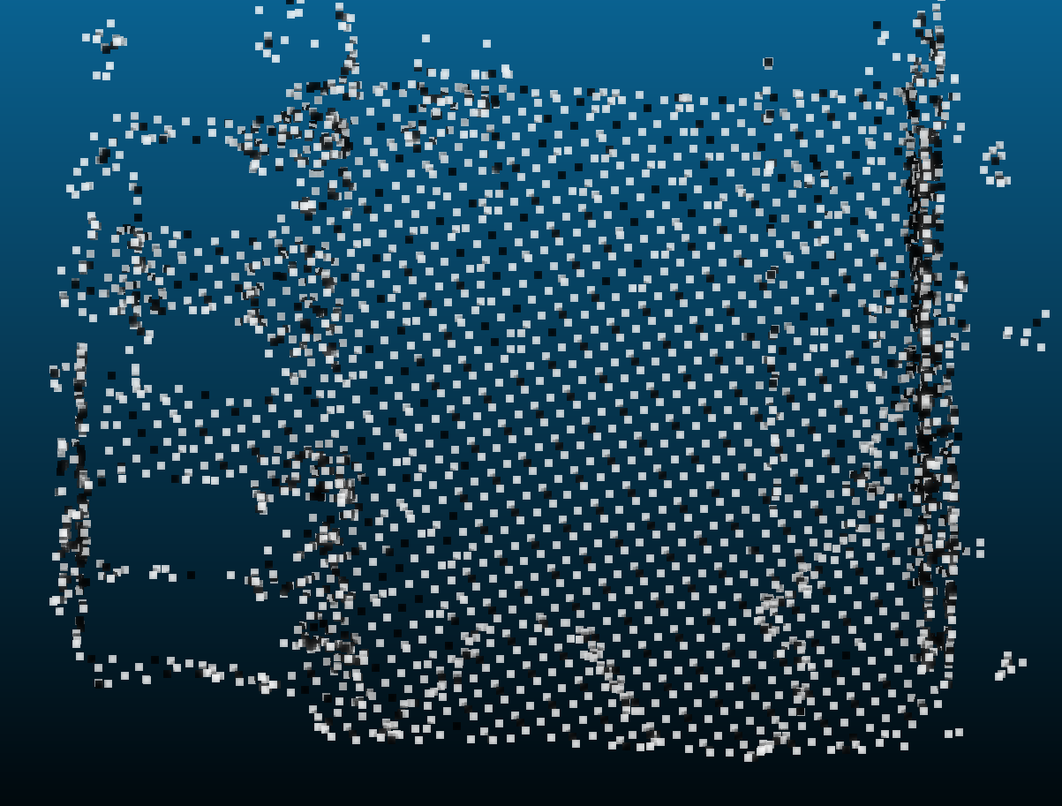
Demo
1+2
(1 to 5 points/m2)

Slide 12
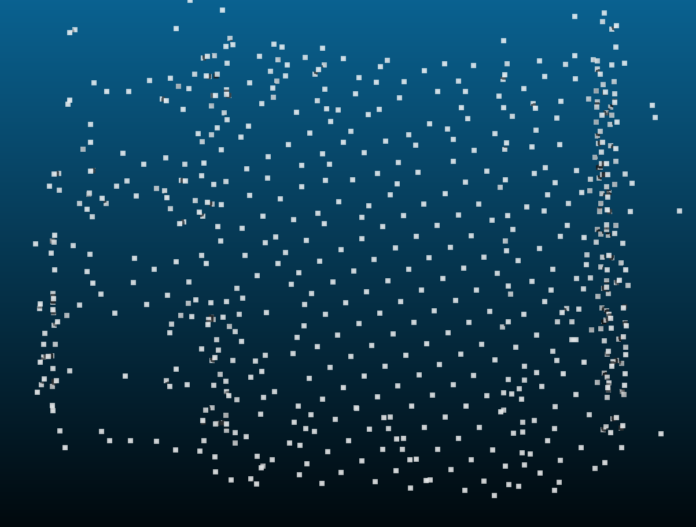
Demo
1
(1 point/m2)

Slide 13
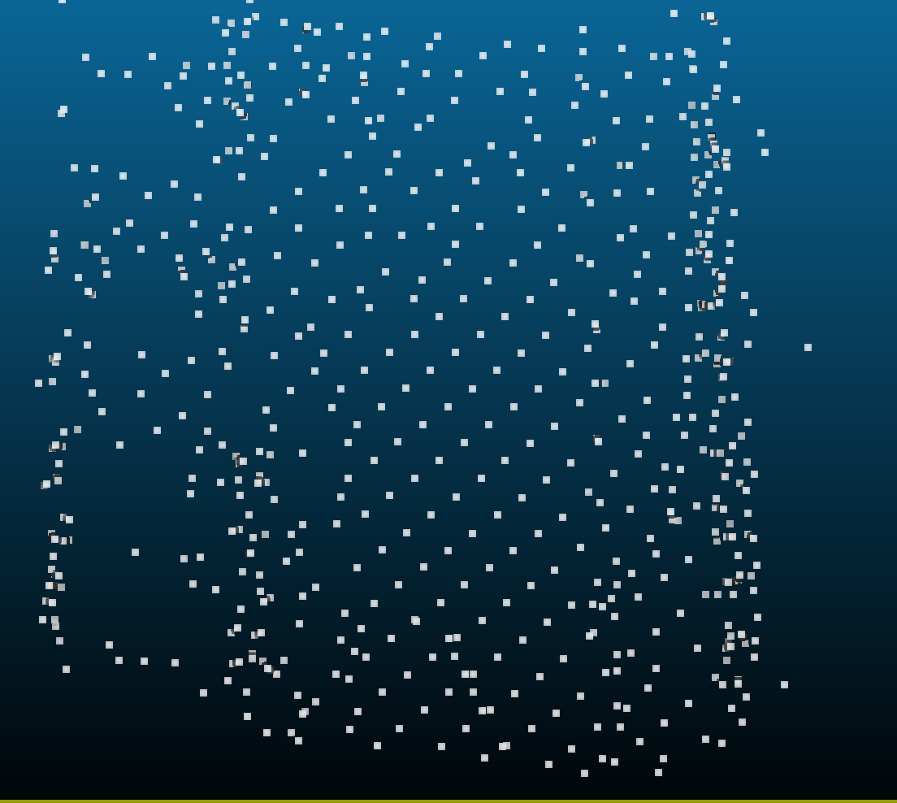
Demo
Note : no duplication, additive LOD.
Separatly :
lOD1 : 653 pts

Slide 14
Demo
Note : no duplication, additive LOD.
Separatly :
lOD1 : 653 pts

Slide 15
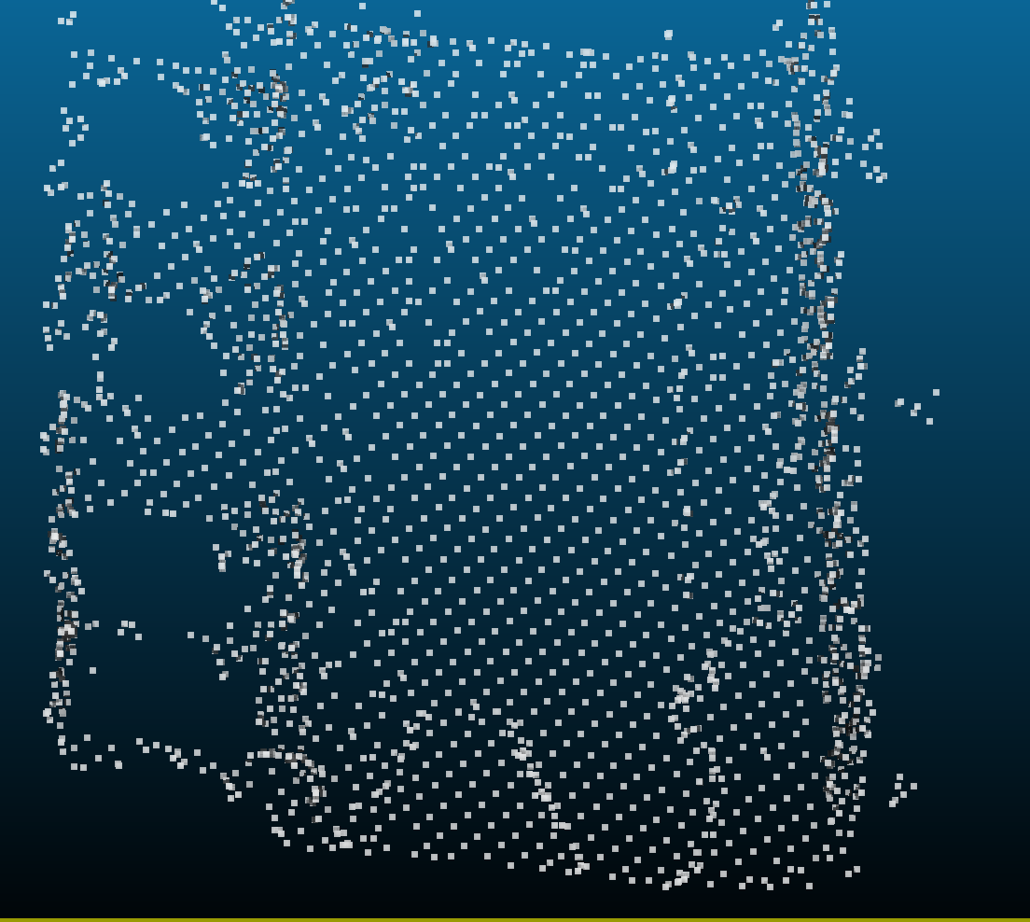
Demo
Note : no duplication, additive LOD.
Separatly :
lOD2 : 2625 pts

Slide 16
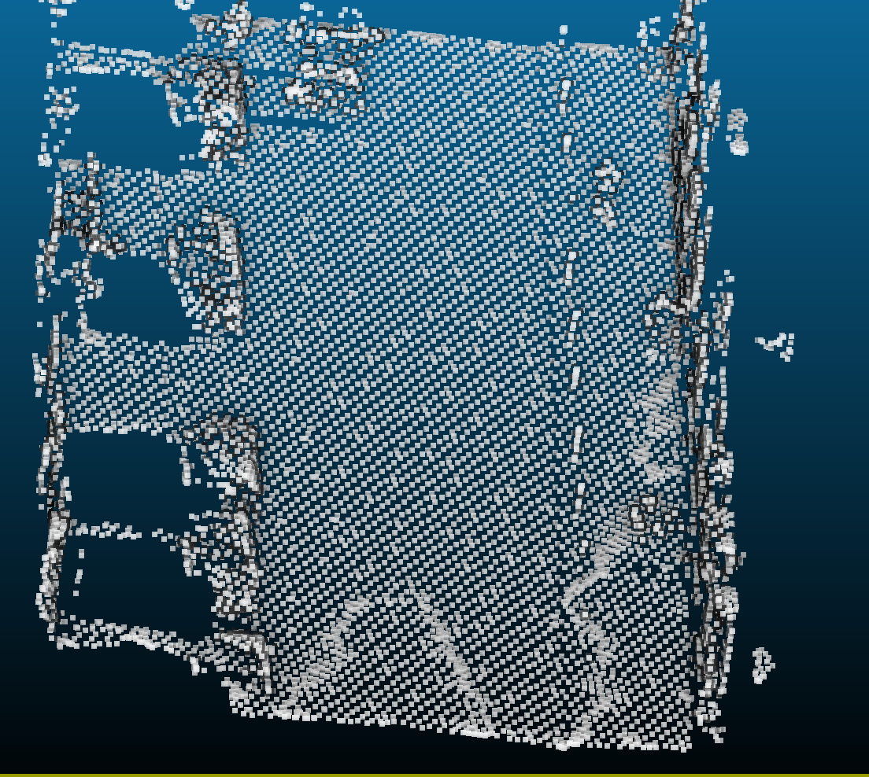
Demo
Note : no duplication, additive LOD.
Separatly :
lOD3 : 11,185 kpts

Slide 17
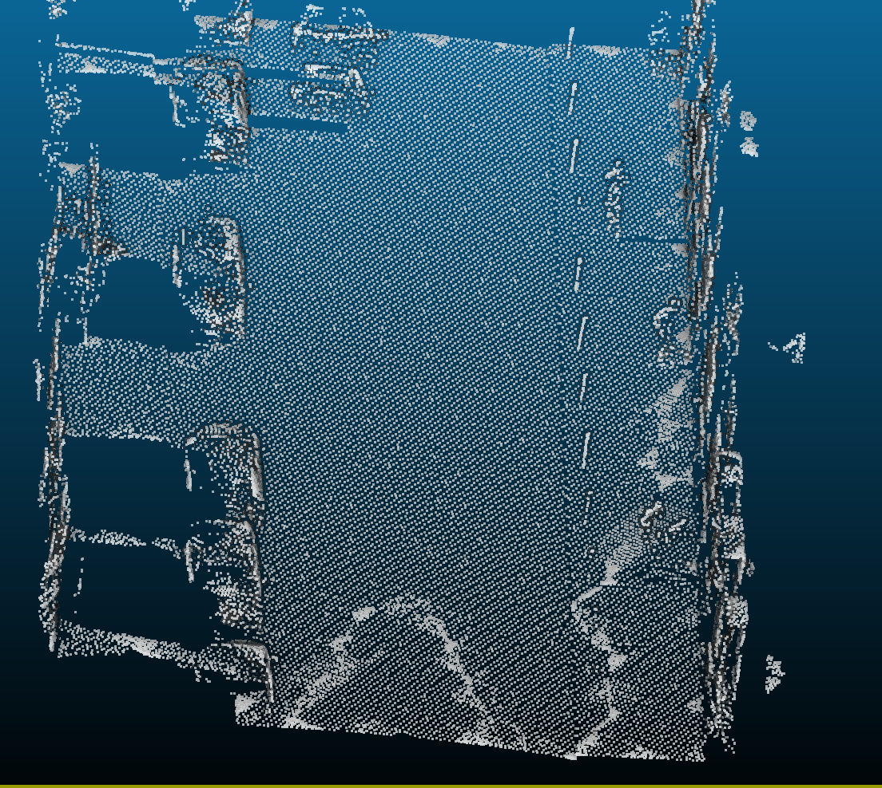
Demo
Note : no duplication, additive LOD.
Separatly :
lOD4 : 41,6 kpts

Slide 18
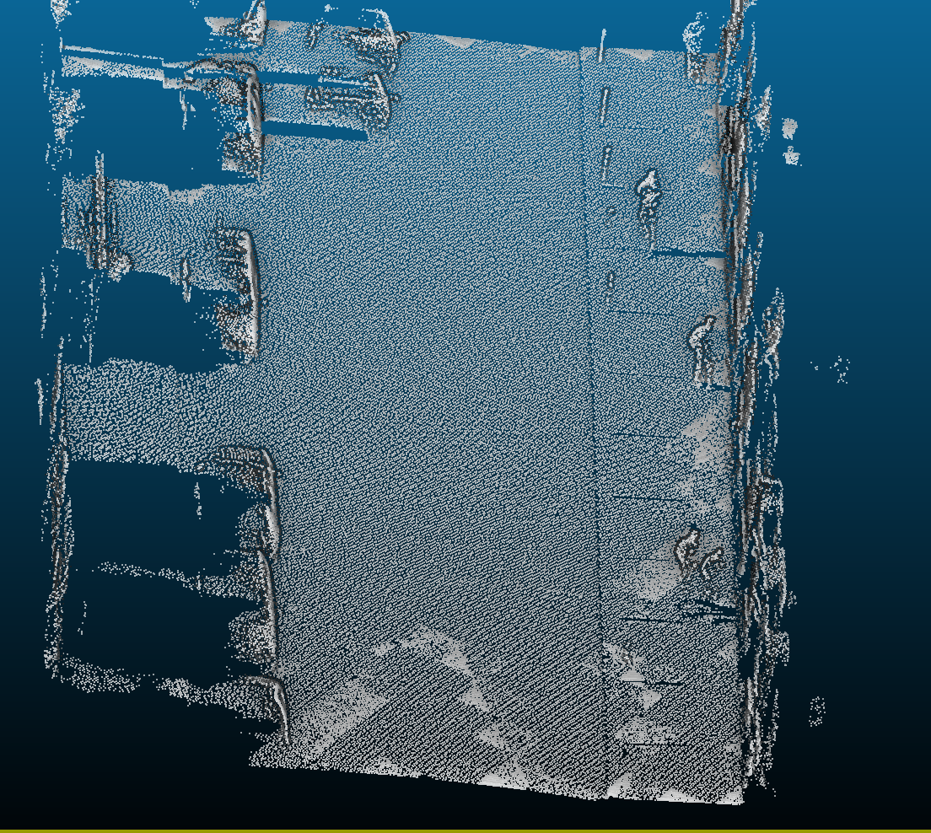
Demo
Note : no duplication, additive LOD.
Separatly :
lOD4 : 124,6 kpts

Slide 19
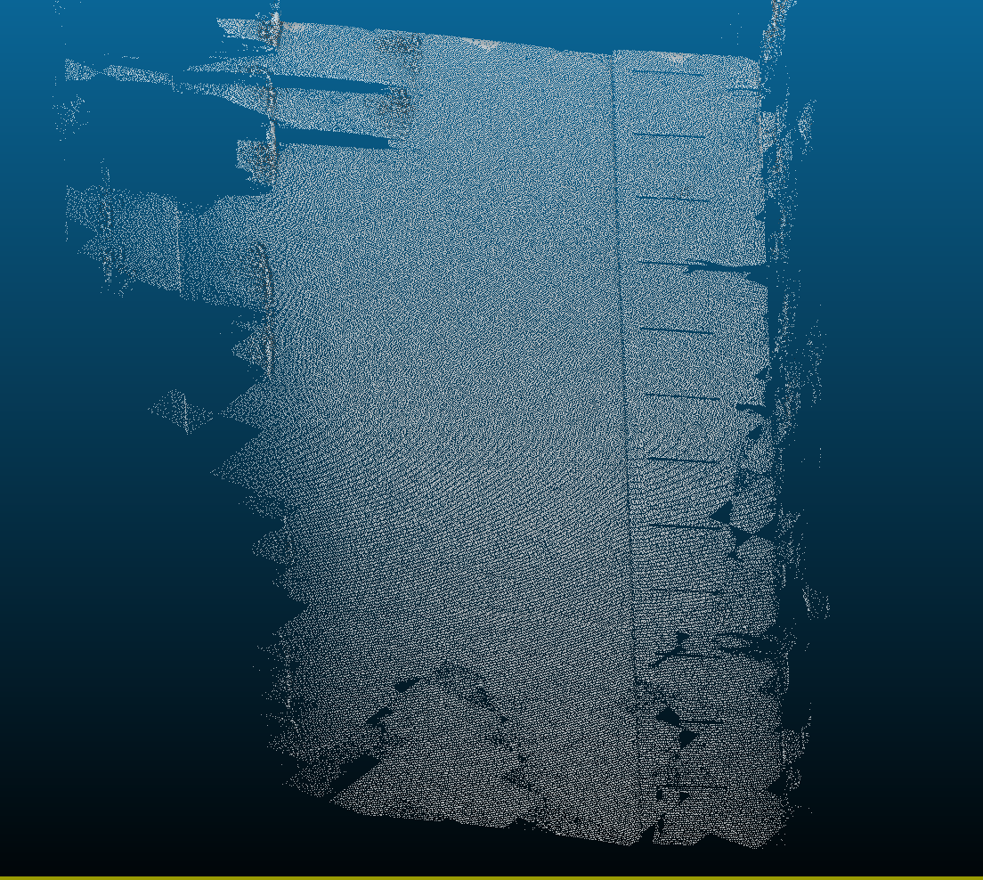
Demo
Note : no duplication, additive LOD.
Separatly :
lOD5: 251,2 kpts

Slide 20
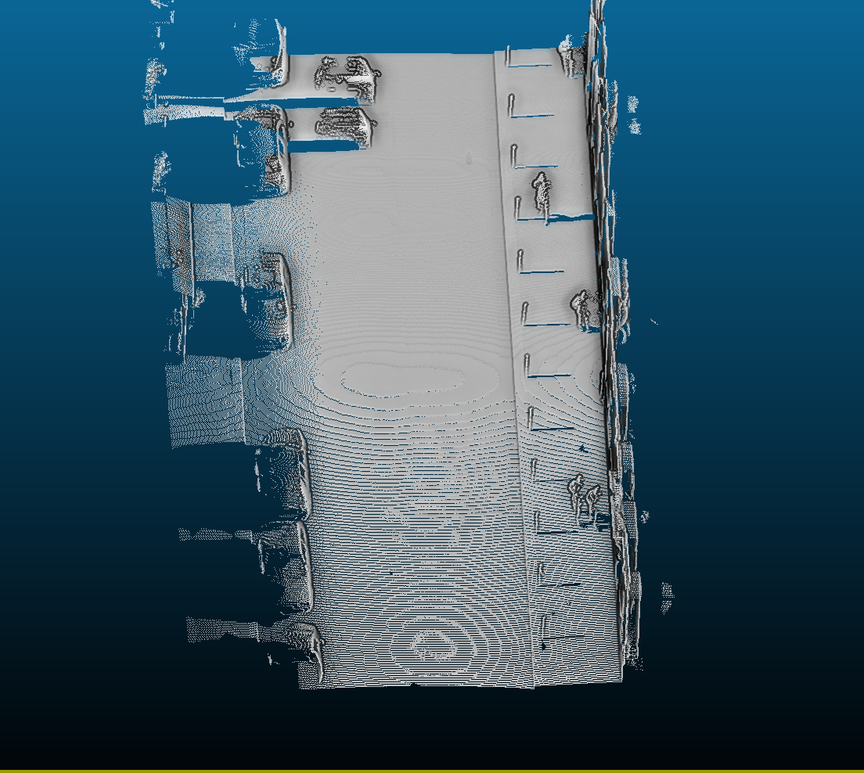
Demo
Original: 1.7 millions pts

Slide 21
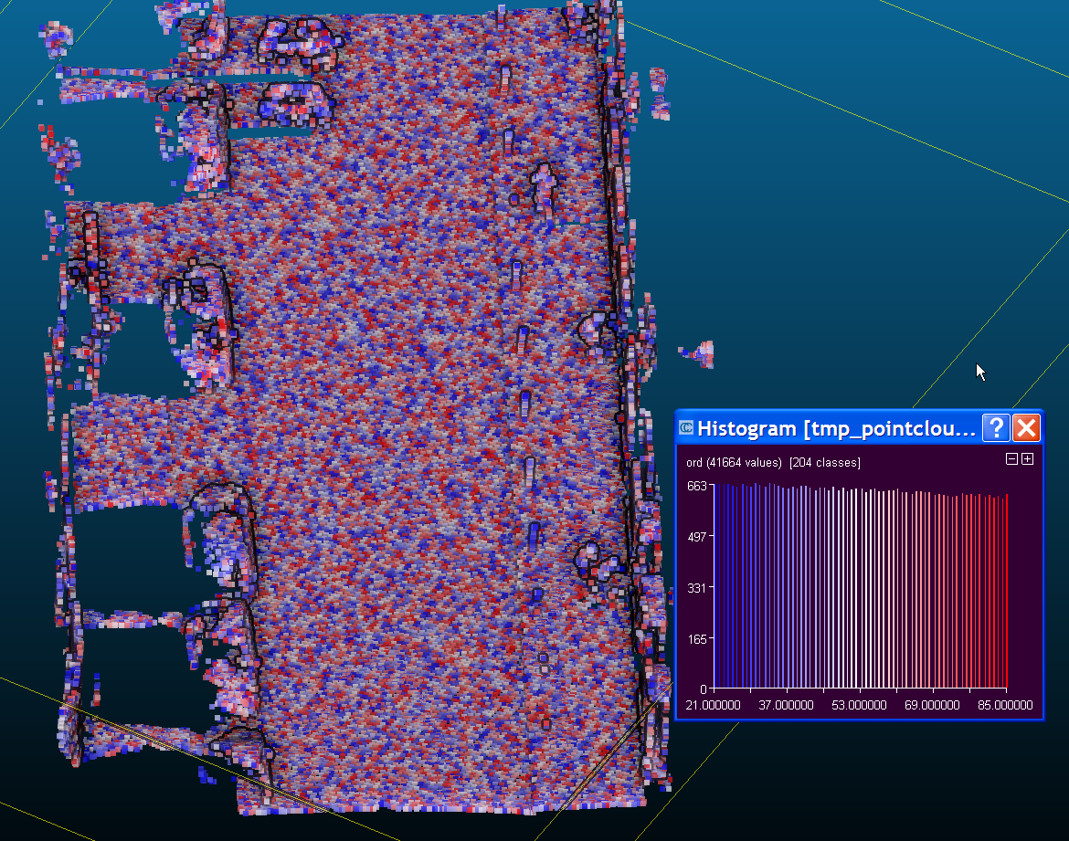
Another nice feature
Inside a level, ordering is random
(e.g. 21 to 85 pts/m2)
Color = order

Slide 22
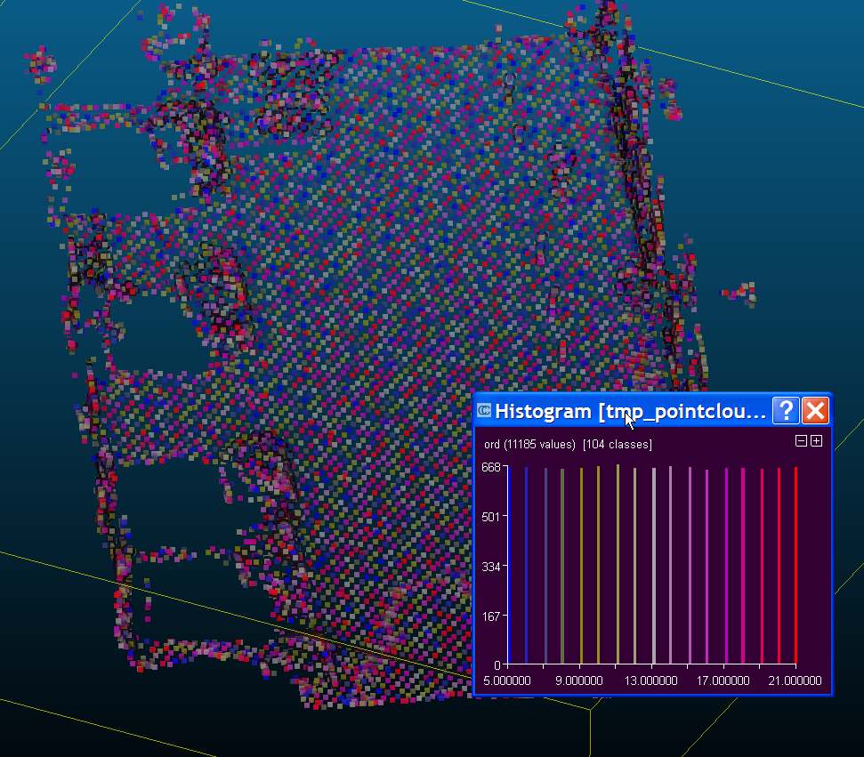
Another nice feature
Inside a level, ordering is random
(e.g. 5 to 21 pts/m2)
Color = order

